Slide 1
UNIT 4- DATA LINK LAYER
LH-5
ROLISHA STHAPIT

Slide 2
CONTENTS
Introduction; Media Access Control (Contention, Controlled Access, Relative Performance); Error Control (Sources of Errors, Error Prevention, Error Detection, Error Correction via Retransmission, Forward Error Correction, Error Control in Practice); Data Link Protocols (Asynchronous Transmission, Synchronous Transmission); Transmission Efficiency.

Slide 3
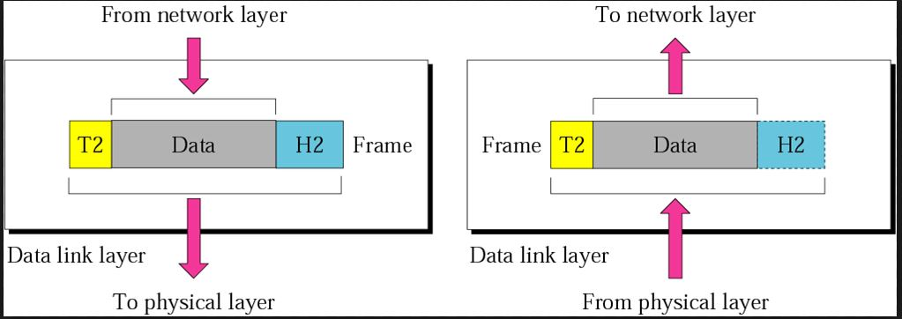
Introduction
The data-link layer is responsible for transferring a datagram across an individual link.
A link is the communication channels that connect two adjacent hosts or routers.
Examples of data link-layer protocols include Ethernet, token ring, FDDI, and PPP.
In order to move a datagram from source host to destination host, the datagram must be moved over each of the individual links in the path.
The data-link layer is responsible for transferring a datagram that comes from the network layer across an individual link.

Slide 4
Functions
Framing and link access: Almost all data link-layer protocols encapsulate each network-layer datagram within a network-layer datagram is inserted, and a number of header fields. A data-link protocol specifies the structure of the frame, as well as a channel access protocol that specifies the rules by which a frame is transmitted onto the link.
Reliable delivery: When a data link-layer protocol provides reliable-delivery service, it guarantees to move each network-layer datagram across the link without error. This is achieved with acknowledgments and retransmissions.
Flow control: A data link-layer protocol can provide flow control in order to prevent the sending node on one side of a link from overwhelming the receiving node on the other side of the link.

Slide 5
Error detection: Many data link-layer protocols provide a mechanism to detect the presence of one or more errors. This is done by having the transmitting node set error-detection bits in the frame, and having the receiving node perform an error check. Error detection is a very common service among link-layer protocols.
Error correction: Error correction is similar to error detection, except that a receiver cannot only detect whether errors have been introduced in the frame but can also determine exactly where in the frame the errors have occurred (and hence correct these errors).
Half-duplex and full-duplex: With full-duplex transmission, the nodes at both ends of a link may transmit packets at the same time. With half-duplex transmission, a node cannot both transmit and receive at the same time.

Slide 6
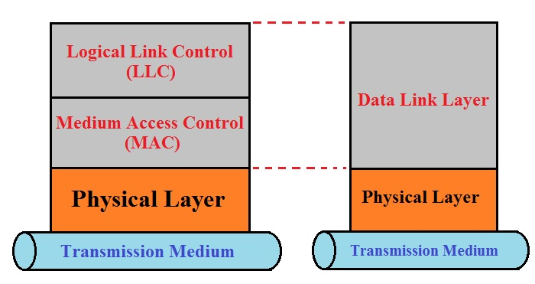
Overview of Logical Link Control (LLC) and Media Access Control (MAC)
The data link layer is made up of two sublayers:
LLC (Logical Link Control) Layer
MAC(Media Access Control)Layer
Both of these two sublayers are responsible for different functions for the data link layer.
LLC interacts with the network layer above and the lower sub-layer, termed as MAC, that interacts with the physical layer below, as shown in the diagram given below:

Slide 7
LLC (Logical Link Control) Layer
LLC is responsible for handling multiple Layer3 protocols (multiplexing/demultiplexing) and link services like reliability and flow control, The functional overview of LLC are:
This sublayer multiplexes protocols running a top the data link layer, and optionally provides flow control, acknowledgment, and error recovery.
The LLC provides addressing and control of the data link. It specifies which mechanisms are to be used for addressing stations over the transmission medium and for controlling the data exchanged between the originator and recipient machines.

Slide 8
MAC Layer
Media Access Control (MAC) sublayer provides control for accessing the transmission medium.
It is responsible for moving data packets from one network interface card (NIC) to another, across a shared transmission medium.
Physical addressing is handled at the MAC sublayer. MAC is also handled at this layer. This refers to the method used to allocate network access to computers and prevent them from transmitting at the same time, causing data collisions.
Common MAC methods include Carrier Sense Multiple Access/Collision Detection (CSMA/CD), used by Ethernet networks, Carrier Sense Multiple Access/Collision Avoidance (CSMA/CA), used by AppleTalk networks, and token passing, used by Token Ring and Fiber Distributed Data Interface (FDDI) networks.

Slide 9
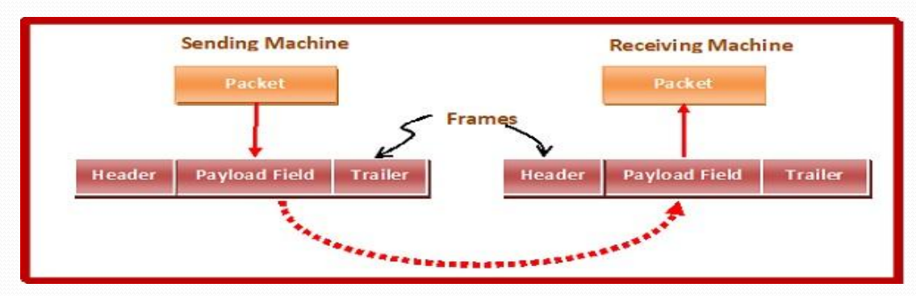
Framing and Flow control Mechanism
Framing:
In the physical layer, data transmission involves synchronized transmission of bits from the source to the destination. The data link layer packs these bits into frames.
Data-link layer takes the packets from the Network Layer and encapsulates them into frames. If the frame size becomes too large, then the packet may be divided into small sized frames. Smaller sized frames makes flow control and error control more efficient.
Then, it sends each frame bit-by-bit on the hardware. At receiver’s end, data link layer picks up signals from hardware and assembles them into frames.

Slide 10
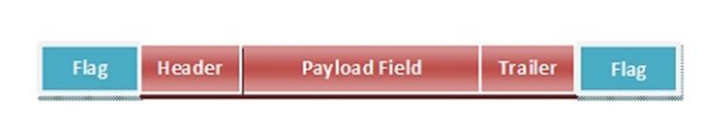
Parts of a Frame
Frame Header − It contains the source and the destination addresses of the frame.
Payload field − It contains the message to be delivered.
Trailer − It contains the error detection and error correction bits.
Flag − It marks the beginning and end of the frame.

Slide 11
Types of Framing
Fixed-sized Framing:
Here the size of the frame is fixed and so the frame length acts as delimiter of the frame. Consequently, it does not require additional boundary bits to identify the start and end of the frame.
Example − ATM cells.
Variable – Sized Framing:
Here, the size of each frame to be transmitted may be different. So additional mechanisms are kept to mark the end of one frame and the beginning of the next frame.
It is used in local area networks.

Slide 12
Media Access Control
Media access control refers to the need to control when computers transmit. With point-to-point full-duplex configurations, media access control is unnecessary because there are only two computers on the circuit, and fullduplex permits either computer to transmit at any time.
Media access control becomes important when several computers share the same communication circuit, such as a point-to-point configuration with a half-duplex configuration that requires computers to take turns or a multipoint configuration in which several computers share the same circuit. Here, it is critical to ensure that no two computers attempt to transmit data at the same time—but if they do, there must be a way to recover from the problem.
There are two fundamental approaches to media access control: contention and controlled access.

Slide 13
Contention
With contention, computers wait until the circuit is free (i.e., no other computers are transmitting) and then transmit whenever they have data to send. Contention is commonly used in Ethernet—Local Area Networks (LANs).
As an analogy, suppose that you are talking with some friends. People listen, and if no one is talking, they can talk. If you want to say something, you wait until the speaker is done and then you try to talk.
Usually, people yield to the first person who jumps in at the precise moment the previous speaker stops. Sometimes, two people attempt to talk at the same time, so there must be some technique to continue the conversation after such a verbal collision occurs.

Slide 14
Controlled Access
With controlled access, one device controls the circuit and determines which clients can transmit at what time. There are two commonly used controlled access techniques: access requests and polling.
With the access request technique, client computers that want to transmit send a request to transmit to the device that is controlling the circuit (e.g., the wireless access point). The controlling device grants permission for one computer at a time to transmit. When one computer has permission to transmit, all other computers wait until that computer has finished, and then, if they have something to transmit, they use a contention technique to send an access request.
The access request technique is like a classroom situation in which the instructor calls on the students who raise their hands. The instructor acts like the controlling access point. When they want to talk, students raise their hands and the instructor recognizes them so they can contribute. When they have finished, the instructor again takes charge and allows someone else to talk. And of course, just like in a classroom, the wireless access point can choose to transmit whenever it likes.

Slide 15
Polling is the process of sending a signal to a client computer that gives it permission to transmit. With polling, the clients store all messages that need to be transmitted. Periodically, the controlling device (e.g., a wireless access point) polls the client to see if it has data to send. If the client has data to send, it does so. If the client has no data to send, it responds negatively, and the controller asks another client if it has data to send. There are several types of polling.
With roll-call polling, the controller works consecutively through a list of clients, first polling client 1, then client 2, and so on, until all are polled. Roll-call polling can be modified to select clients in priority so that some get polled more often than others. For example, one could increase the priority of client 1 by using a polling sequence such as 1, 2, 3, 1, 4, 5, 1, 6, 7, 1, 8, 9.
With hub polling (often called token passing), one device starts the poll and passes it to the next computer on the multipoint circuit, which sends its message and passes the poll to the next. That computer then passes the poll to the next, and so on, until it reaches the first computer, which restarts the process again.

Slide 16
Relative Performance:
Which media access control approach is best: controlled access or contention? There is no simple answer. The key consideration is throughput —which approach will permit the most amount of user data to be transmitted through the network.
In general, contention approaches work better than controlled approaches for small networks that have low usage. In this case, each computer can transmit when necessary, without waiting for permission. Because usage is low, there is little chance of a collision. In contrast, computers in a controlled access environment must wait for permission, so even if no other computer needs to transmit, they must wait for the poll.
The reverse is true for large networks with high usage: Controlled access works better. In high-volume networks, many computers want to transmit, and the probability of a collision using contention is high. Collisions are very costly in terms of throughput because they waste circuit capacity during the collision and require both computers to retransmit later. Controlled access prevents collisions and makes more efficient use of the circuit, and although response time does increase, it does so more gradually

Slide 17
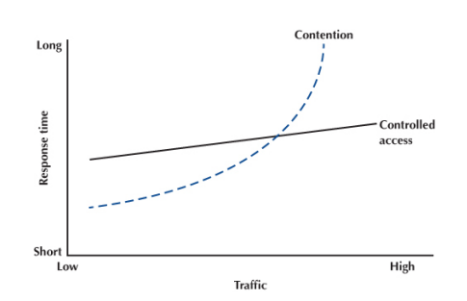
The key for selecting the best access control technique is to find the crossover point between controlled and contention. Although there is no one correct answer, because it depends on how many messages the computers in the network transmit, most experts believe that the crossover point is often around 20 computers (lower for busy computers, higher for less-busy computers). For this reason, when we build shared multipoint circuits like those often used in LANs or wireless LANs, we try to put no more than 20 computers on any one shared circuit.
Figure: Relative responses time

Slide 18
Error Control
Networks must be able to transfer data from one device to another with acceptable accuracy. For most applications, a system must guarantee that the data received are identical to the data transmitted. Any time data are transmitted from one node to the next, they can become corrupted in passage.
Many factors can alter one or more bits of a message. Some applications require a mechanism for detecting and correcting errors. Some applications can tolerate a small level of error.
For example, random error in audio or video transmissions may be tolerable, but when we transfer text, we expect a very high level of accuracy. At the data-link layer, if a frame is corrupted between the two nodes, it needs to be corrected before it continues its journey to other nodes.
However, most link-layer protocols simply discard the frame and let the upper-layer protocols handle the retransmission of the frame. Some multimedia applications, however, try to correct the corrupted frame.

Slide 19
Source of Errors
Line noise and distortion can cause data communication errors. The focus in this section is on electrical media such as twisted-pair wire and coaxial cable, because they are more likely to suffer from noise than are optical media such as fiber-optic cable.
Noise is introduced by equipment or natural disturbances, and it degrades the performance of a communication circuit. Noise manifests itself as extra bits, missing bits, or bits that have been "flipped".
Figure below summarizes the major sources of error and ways to prevent them. The first six sources listed there are the most important; the last three are more common in analog rather than digital circuits.

Slide 20
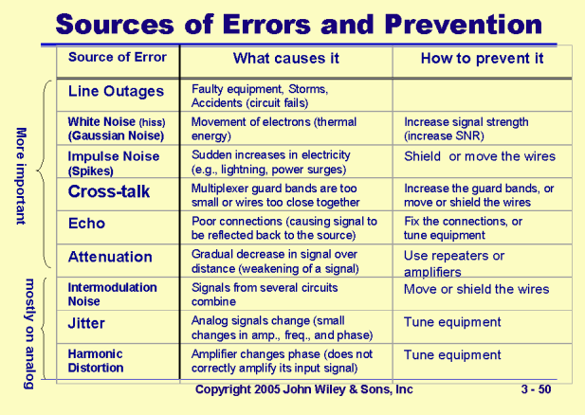

Slide 21
Line outages are a catastrophic cause of errors and incomplete transmission. Occasionally, a communication circuit fails for a brief period. This type of failure may be caused by faulty telephone end office equipment, storms, loss of the carrier signal, and any other failure that causes a short circuit. The most common cause of line outages are storms that cause damage to circuits or facilities.
White noise or Gaussian noise is caused by the thermal agitation of electrons and therefore is inescapable. Even if the equipment were perfect and the wires were perfectly insulated from any and all external interference, there still would be some white noise. White noise usually is not a problem unless it becomes so strong that it obliterates the transmission. In this case, the strength of the electrical signal is increased so it overpowers the white noise; in technical terms, we increase the signal-to- noise ratio.
Impulse noise (sometimes called spikes) is the primary source of errors in data communications. Impulse noise is heard as a click or a crackling noise and can last as long as 1/100 of a second. Some of the sources of impulse noise are voltage changes in adjacent lines, lightning flashes during thunderstorms, fluorescent lights, and poor connections in circuits.

Slide 22
Cross-talk occurs when one circuit picks up signals in another. You experience cross- talk during telephone calls when you hear other conversations in the background. It occurs between pairs of wires that are carrying separate signals, in multiplexed links carrying many discrete signals, or in microwave links in which one antenna picks up a minute reflection from another antenna.
Echoes can cause errors. Echoes are caused by poor connections that cause the signal to reflect back to the transmitting equipment. If the strength of the echo is strong enough to be detected, it causes errors.
Attenuation is the loss of power a signal suffers as it travels from the transmitting computer to the receiving computer. Some power is absorbed by the medium or is lost before it reaches the receiver. As the medium absorbs power, the signal becomes weaker, and the receiving equipment has less and less chance of correctly interpreting the data.
Intermodulation noise is a special type of cross-talk. The signals from two circuits combine to form a new signal that falls into a frequency band reserved for another signal. This type of noise is similar to harmonics in music. data being transmitted because minute variations.

Slide 23
Jitter may affect the accuracy of the in amplitude, phase, and frequency always occur. This jitter may be random or periodic. Phase jitter during a telephone call causes the voice to fluctuate in volume.
Harmonic distortion usually is caused by an amplifier on a circuit that does not correctly represent its output with what was delivered to it on the input side. Phase hits are short- term shifts "out of phase," with the possibility of a shift back into phase.
In general, errors are more likely to occur in wireless, microwave, or satellite transmission than transmission through cables. Therefore, error detection is more important when using radiated media than guided media.

Slide 24
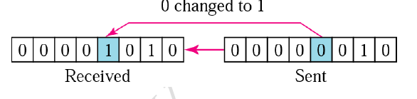
Types of Errors
Single-Bit Error : In a single-bit error, only one bit in the data unit has changed.
Burst Error: A burst error means that 2 or more bits in the data unit have changed.

Slide 25
Error Prevention
Error prevention is very important. There are many techniques to prevent errors (or at least reduce them), depending on the situation.
Shielding (protecting wires by covering them with an insulating coating) is one of the best ways to prevent impulse noise, cross-talk, and intermodulation noise. Many different types of wires and cables are available with different amounts of shielding. In general, the greater the shielding, the more expensive the cable and the more difficult it is to install.
Moving cables away from sources of noise (especially power sources) can also reduce impulse noise, cross-talk, and intermodulation noise. For impulse noise, this means avoiding lights and heavy machinery. Locating communication cables away from power cables is always a good idea. For cross-talk, this means physically separating the cables from other communication cables.
Cross-talk and intermodulation noise is often caused by improper multiplexing. Changing multiplexing techniques (e.g., from FDM [Frequency Division Multiplexing] to TDM [Time Division Multiplexing]) or changing the frequencies or size of the guardbands in FDM can help.

Slide 26
Many types of noise (e.g., echoes, white noise) can be caused by poorly maintained equipment or poor connections and splices among cables. This is particularly true for echo in fiber-optic cables, which is almost always caused by poor connections. The solution here is obvious: Tune the transmission equipment and redo the connections.
To avoid attenuation, telephone circuits have repeaters or amplifiers spaced throughout their length. The distance between them depends on the amount of power lost per unit length of the transmission line.
An amplifier takes the incoming signal, increases its strength, and retransmits it on the next section of the circuit. They are typically used on analog circuits such as the telephone company’s voice circuits.
The distance between the amplifiers depends on the amount of attenuation, although 1- to 10-mile intervals are common. On analog circuits, it is important to recognize that the noise and distortion are also amplified, along with the signal. This means some noise from a previous circuit is regenerated and amplified each time the signal is amplified.

Slide 27
Error Detection:
There are many reasons such as noise, cross-talk etc., which may help data to get corrupted during transmission.
Most of the applications would not function expectedly if they receive erroneous data.
Data-link layer uses some error control mechanism to ensure that frames (data bit streams) are transmitted with certain level of accuracy.
Whenever a message is transmitted, it may get scrambled by noise or data may get corrupted.
To avoid this, we use error-detecting codes which are additional data added to a given digital message to help us detect if any error has occurred during transmission of the message.
Basic approach used for error detection is the use of redundancy bits, where additional bits are added to facilitate detection of errors.

Slide 28
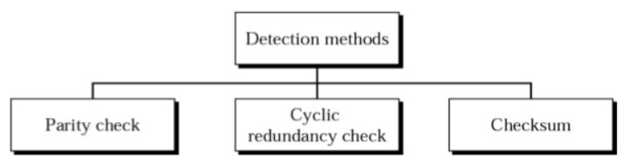
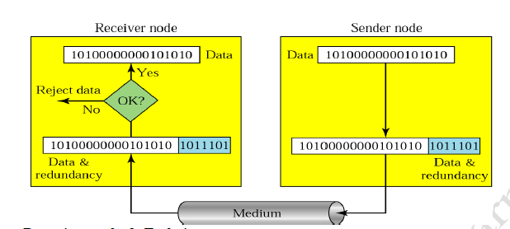

Slide 29
The common error detection methods are:
❖ Parity Check
❖ Checksum
❖ Cyclic Redundancy Check (CRC)

Slide 30
Parity Check:
In parity check, a parity bit is added to every data unit so that the total number of 1s is even (or odd for odd-parity).
The most common and least expensive mechanism for error- detection is the simple parity check. In this technique, a redundant bit called parity bit, is appended to every data unit so that the number of 1s in the unit (including the parity becomes even).
Simple Parity Check:
In this a redundant bit is added to a string of data so that total number of 1’s in the data becomes even or not.
Blocks of data from the source are subjected to a check bit or Parity bit generator form, where a parity of 1 is added to the block if it contains an odd number of 1‘s (ON bits) and 0 is added if it contains an even number of 1‘s. At the receiving end the parity bit is computed from the received data bits and compared with the received parity bit, as shown in Fig. This scheme makes the total number of 1‘s even, that is why it is called even parity checking.
Simple parity check can detect all single-bit errors. It can detect burst errors only if the total number of errors in each data unit is odd.

Slide 31
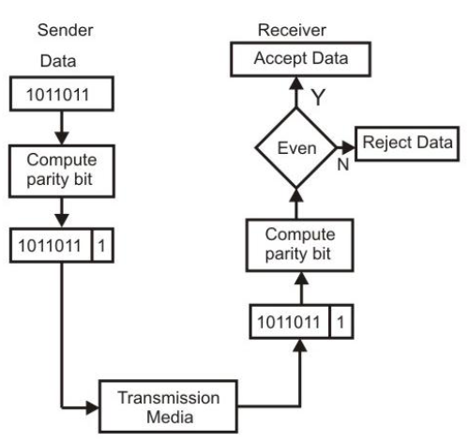
Example using even parity concept
Eg 1: data to be transmitted : 10110101
5 1’s in the data
Transmitted word: 101101011
If receiver gets 101101011 parity check Ok – accepted
Eg 2: data to be transmitted : 10110001
4 1’s in the data
Transmitted word: 101100010

Slide 32
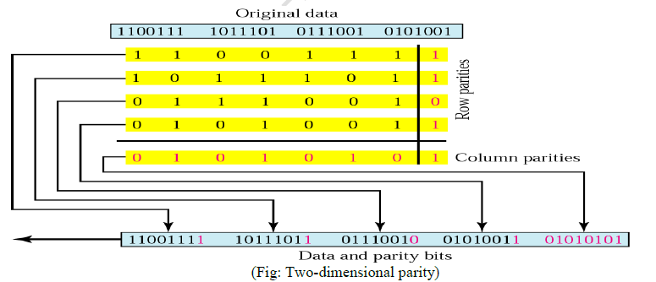
Longitudinal (2-D) Parity:
In two-dimensional parity check, a block of bits is divided into rows and a redundant row of bits is added to the whole block.

Slide 33
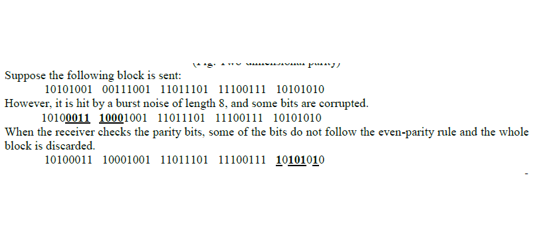

Slide 34
Checksum
It is based on the redundancy. Many computer network send a checksum along with each packet to help the receiver detect errors.
To compute a checksum, the sender treats the data as a sequence of binary integers and form the sum of all units in the message which is called checksum.
Checksum Generator:
In the sender side the data unit is divided into equal segment of n bits.
The segments are added.
The total is then complemented and appended to the end of the original data unit as redundancy bit called checksum bit.
The extended data is transmitted across the network.

Slide 35
Checksum Checker:
In the receiver side the data unit is divided into k sections each of n bits.
All sections are added to get the sum.
The total is then complemented (1’s complement).
If the result is zero (0) the data is accepted otherwise they are rejected.

Slide 36
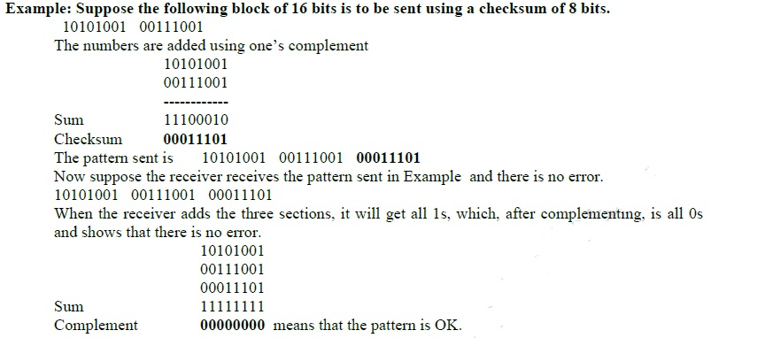

Slide 37
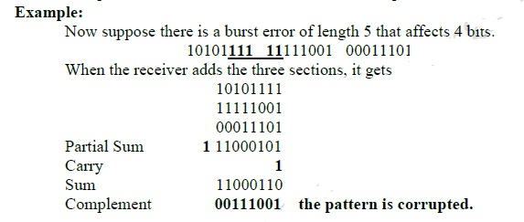

Slide 38
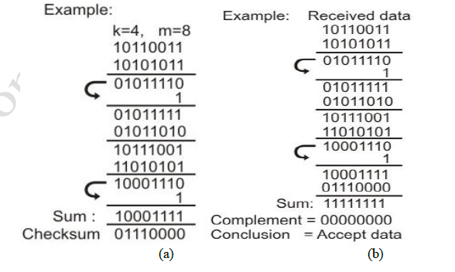
10110011, 10101011, 01011010, 11010101

Slide 39
Cyclic Redundancy Check (CRC)
This Cyclic Redundancy Check is the most powerful and easy to implement technique.
Unlike checksum scheme, which is based on addition, CRC is based on binary division i.e. modulo 2 division (X-OR)
In CRC, a sequence of redundant bits, called cyclic redundancy check bits, are appended to the end of data unit so that the resulting data unit becomes exactly divisible by a second, predetermined binary number.
At the destination, the incoming data unit is divided by the same number. If at this step there is no remainder, the data unit is assumed to be correct and is therefore accepted.
A remainder indicates that the data unit has been damaged in transit and therefore must be rejected.
The generalized technique can be explained as follows:

Slide 40
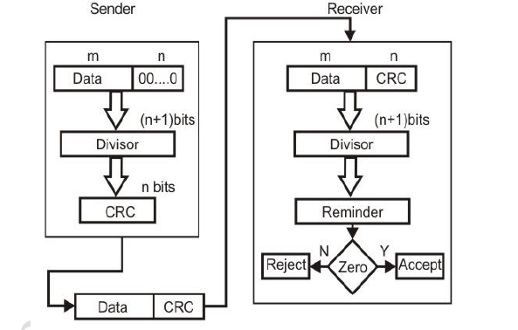
If a k bit message is to be transmitted, the transmitter generates an r-bit sequence, known as Frame Check Sequence (FCS) so that the (k+r) bits are actually being transmitted.
Now this r-bit FCS is generated by dividing the original number, appended by r zeros, by a predetermined number.
This number, which is (r+1) bit in length, can also be considered as the coefficients of a polynomial, called Generator Polynomial.
The remainder of this division process generates the r-bit FCS.
On receiving the packet, the receiver divides the (k+r) bit frame by the same predetermined number and if it produces no remainder, it can be assumed that no error has occurred during the transmission.

Slide 41
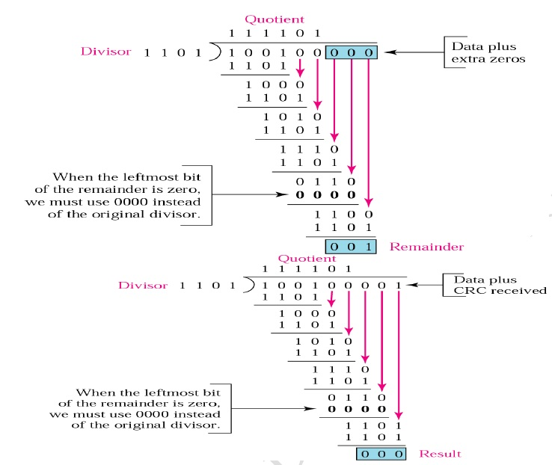
Example
At source side:
Original message: 100100 (m)
Predetermined number/ divisor: 1101 (p)
FCS / appended bits = p-1 =4-1 = 3 bits (n)
New data : 100100000
At receiver side: 100100000+CRC

Slide 42
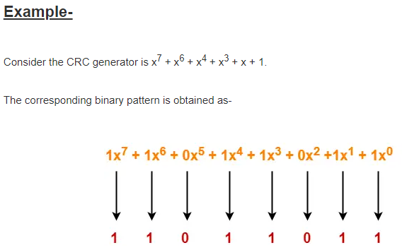

Slide 43
Problem 1
A bit stream 1101011011 is transmitted using the standard CRC method. The generator polynomial is x^4+x+1. What is the actual bit string transmitted?
Solution:
The generator polynomial G(x) = x^4 + x + 1 is encoded as 10011.
Clearly, the generator polynomial consists of 5 bits.
So, a string of 4 zeroes (5-1) is appended to the bit stream to be transmitted.
The resulting bit stream is 11010110110000.

Slide 44
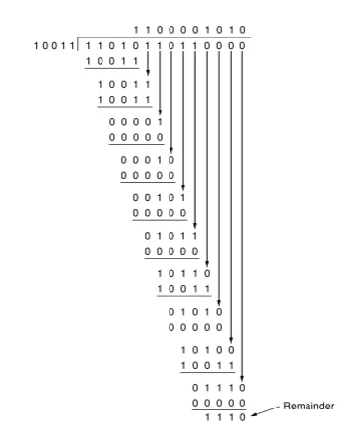
From here, CRC = 1110.
Now,
The code word to be transmitted is obtained by replacing the last 4 zeroes of 11010110110000 with the CRC.
Thus, the code word transmitted to the receiver = 11010110111110.

Slide 45
Problem 2
A bit stream 10011101 is transmitted using the standard CRC method. The generator polynomial is x³+1.
What is the actual bit string transmitted?
Suppose the third bit from the left is inverted during transmission. How will receiver detect this error?
Solution-
Part-01:
The generator polynomial G(x) = x³ + 1 is encoded as 1001.
Clearly, the generator polynomial consists of 4 bits.
So, a string of 3 zeroes is appended to the bit stream to be transmitted.
The resulting bit stream is 10011101000.
Now, the binary division is performed as-

Slide 46
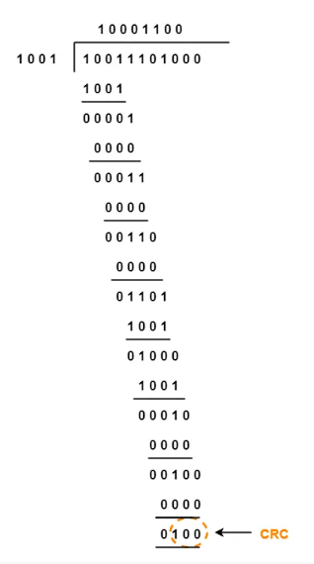
From here, CRC = 100.
Now,
The code word to be transmitted is obtained by replacing the last 3 zeroes of 10011101000 with the CRC.
Thus, the code word transmitted to the receiver = 10011101100

Slide 47
Part-02:
According to the question,
Third bit from the left gets inverted during transmission.
So, the bit stream received by the receiver = 10111101100.
Now,
Receiver receives the bit stream = 10111101100.
Receiver performs the binary division with the same generator polynomial as-

Slide 48
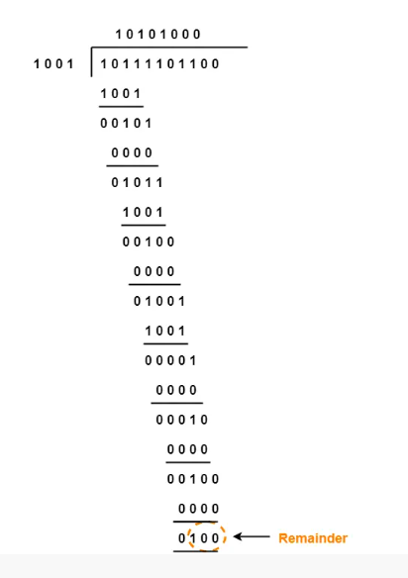
From here,
The remainder obtained on division is a non-zero value.
This indicates to the receiver that an error occurred in the data during the transmission.
Therefore, receiver rejects the data and asks the sender for retransmission.

Slide 49
Error Correction
Error correction codes are used to detect and correct the errors when data is transmitted from the sender to the receiver.
Error correction is the additional ability to reconstruct the original, error-free data.
Error correction can be done in two ways:
Backward Error Correction: When the receiver detects an error in the data received, it requests back the sender to retransmit the data unit.
Forward Error Correction: When the receiver detects some error in the data received, it executes error-correcting code, which helps it to auto-recover and to correct some kinds of errors.
E.g., Hamming Code

Slide 50
Hamming Code:
Hamming code is a set of error-correction codes that can be used to detect and correct the errors that can occur when the data is moved or stored from the sender to the receiver.
It is technique developed by R.W. Hamming for error correction.
Redundant bits:
Redundant bits are extra binary bits that are generated and added to the information-carrying bits of data transfer to ensure that no bits were lost during the data transfer.
The number of redundant bits can be calculated using the following formula:
2^r ≥ m + r + 1
where, r = redundant bit, m = data bit
Suppose the number of data bits is 7, then the number of redundant bits can be calculated using:
= 2^4 ≥ 7 + 4 + 1
Thus, the number of redundant bits= 4

Slide 51
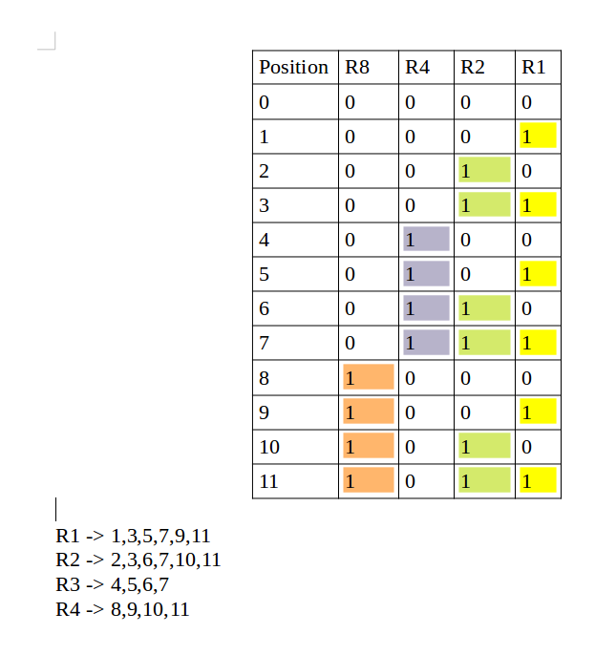
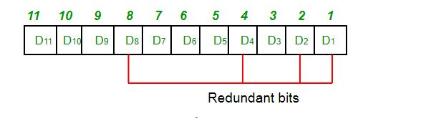
Position of the redundant bits:
For seven-bit ASCII code, redundancy bits are placed in positions 1, 2, 4 and 8.

Slide 52
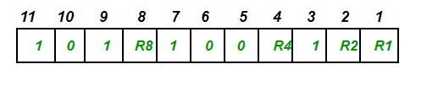
Example:
Suppose the data to be transmitted is 1011001, the bits will be placed as follows:
Total number of data bits ‘m’ = 7
Number of redundant bits r: 2^r ≥ m + r + 1
2^r ≥ 7 + r + 1
2^4 ≥ 7 + 4 + 1 = 12 (Satisfied)
Therefore, r=4 and total number of bits = m+r =7+4=11;

Slide 53
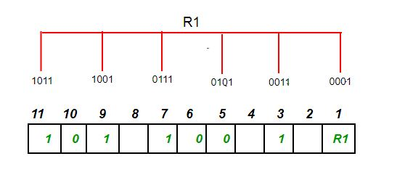
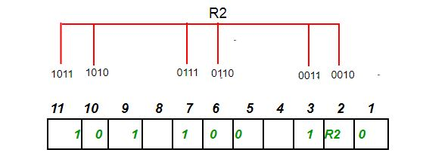
Determining the Parity bits:
1. Determining R1 bit: (R1: bits 1, 3, 5, 7, 9, 11)
To find the redundant bit R1, we check for even parity. Since the total number of 1’s in all the bit positions corresponding to R1 is an even number, the value of R1 = 0
2. Determining R2 bit: (R2: bits 2,3,6,7,10,11)
To find the redundant bit R2, we check for even parity. Since the total number of 1’s in all the bit positions corresponding to R2 is odd the value of R2=1

Slide 54
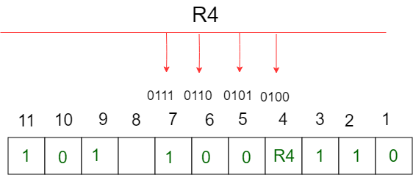
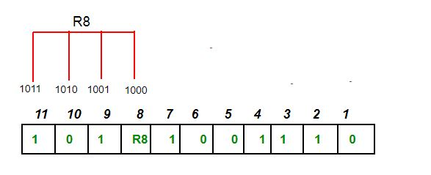
3. Determining R4 bit: (R4: bits 4, 5, 6, 7)
To find the redundant bit R4, we check for even parity. Since the total number of 1’s in all the bit positions corresponding to R4 is odd the value of R4 = 1.
4. Determining R8 bit: (R8: bit 8,9,10,11)
To find the redundant bit R8, we check for even parity. Since the total number of 1’s in all the bit positions corresponding to R8 is an even number the value of R8 = 0.

Slide 55

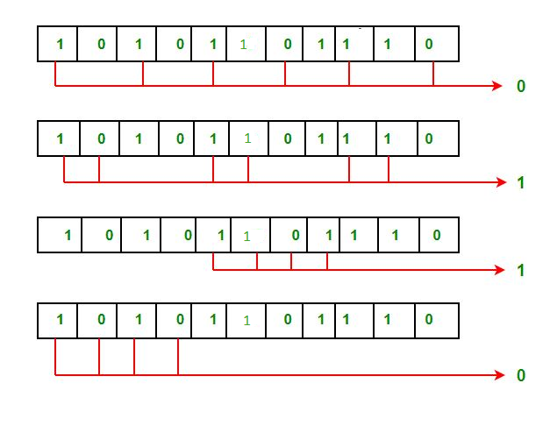
Thus, the data transferred is:
Suppose in the above example the 6th bit is changed from 0 to 1 during data transmission, then it gives new parity values in the binary number:
The bits give the binary number as 0110 whose decimal representation is 6. Thus, the bit 6 contains an error. To correct the error the 6th bit is changed from 1 to 0.

Slide 56
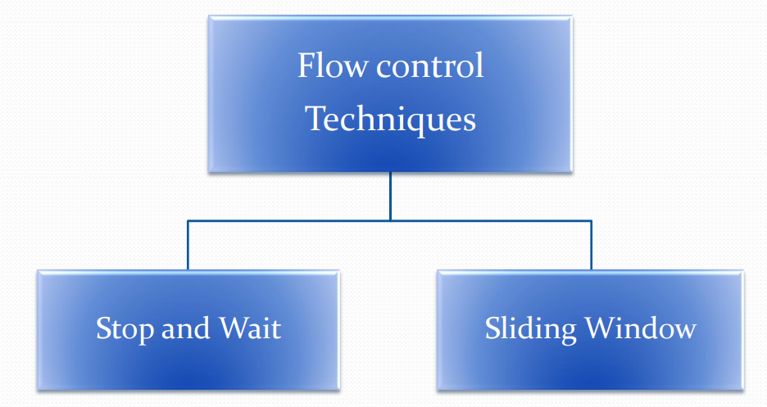
Flow Control
Flow control is an important issue in data link layer that control data between sender and receiver
When a data frame (Layer-2 data) is sent from one host to another over a single medium, it is required that the sender and receiver should work at the same speed. That is, sender sends at a speed on which the receiver can process and accept the data.
What if the speed (hardware/software) of the sender or receiver differs? If sender is sending too fast the receiver may be overloaded, (swamped) and data may be lost.
Flow Control coordinates that amount of data that can be sent before receiving acknowledgement.
It makes the sender wait for some sort of an ACK before continuing to send more data.
Flow control tells the sender how much data to be sent.

Slide 57
1. Stop and Wait Flow Control
Stop and wait flow control protocols works under the following assumptions:
Data transmission in one direction only
Channel is error free
A source entity transmits a frame. After reception, the destination entity indicates its willingness to accept another frame by sending back an acknowledgment to the frame just received.
The source must wait until it receives the acknowledgment before sending the next frame. The destination can thus stop the flow of data by simply withholding acknowledgment. With the use of multiple frames for a single message, the stop and-wait procedure may be inadequate. The essence of the problem is that only one frame at a time can be in transit.
For very high data rates, or for very long distances between sender and receiver, stop- and wait flow control provides inefficient line utilization.
After sending the frame the timer starts. A time out period is used where frames are not acknowledged by the receiver and are retransmitted automatically by the sender.

Slide 58
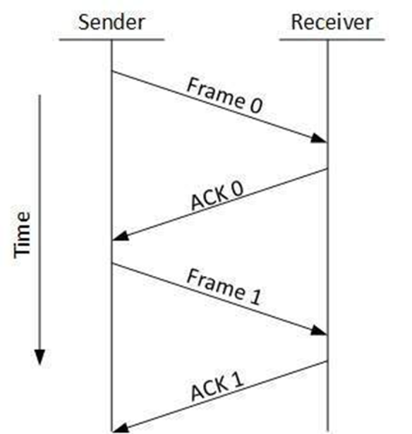
Advantages
Each frame is transmitted only after first frame is acknowledged.
Data frame is not lost.
Disadvantages
Inefficient, only one frame can be in transmission at a time.
The time spent for waiting acknowledgment between each frame add significant amount to total transmission time.

Slide 59

Sliding Window Protocol
Major drawback of stop-and-wait flow control is only one frame can be transmitted at a time; this leads to inefficiency if propagation delay is much longer than transmission delay.
Sliding window flow control allows the transmission of multiple frame. It assigns each frame a k-bit sequence number and the range of sequence no. is
Let us examine how this might work for two stations, A and B, connected via a full-duplex link. Station B allocates buffer space for n frames. Thus, B can accept n frames, and A is allowed to send n frames without waiting for any acknowledgments.
To keep track of which frames have been acknowledged, each is labeled with a sequence number. B acknowledges a frame by sending an acknowledgment that includes the sequence number of the next frame expected. This acknowledgment also implicitly announces that B is prepared to receive the next n frames, beginning with the number specified. This scheme can also be used to acknowledge multiple frames.

Slide 60
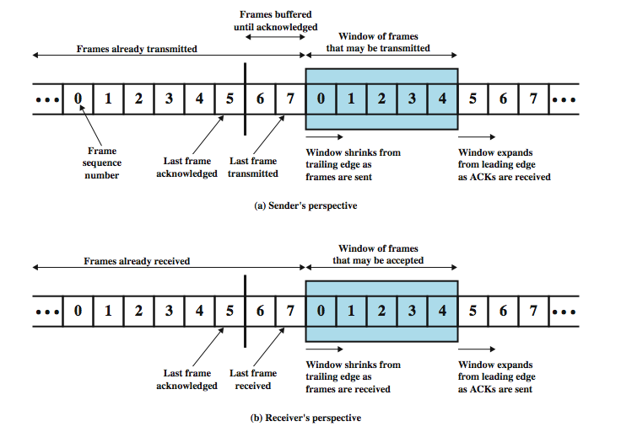

Slide 61
Assume the use of a 3-bit sequence number.
The frames are numbered sequentially from 0 through 7 then the same numbers are reused for subsequent frames. The shaded rectangle indicates the frames that may be sent.
The sender may transmit five frames, beginning with frame 0.
Each time a frame is sent, the shaded window shrinks. Each time an acknowledgment is received, the shaded window grows.
Frames between the vertical bar and the shaded window have been sent but not yet acknowledged. The sender must buffer these frames in case they need to be retransmitted.
In full duplex link it can piggyback acknowledgement.
If two stations exchange data, each needs to maintain two windows, one for transmit and one for receive, and each side needs to send the data and acknowledgments to the other.
To provide efficient support for this requirement, a feature known as piggybacking is typically provided. Each data frame includes a field that holds the sequence number of that frame plus a field that holds the sequence number used for acknowledgment.

Slide 62
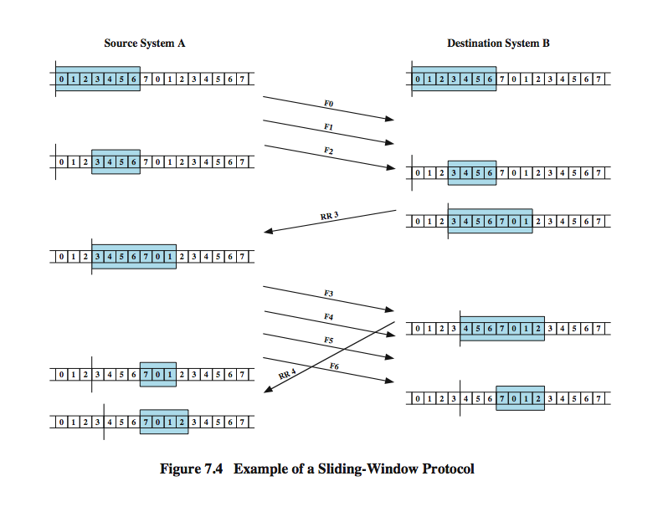
Sliding Window Example

Slide 63
Initially, A and B have windows indicating that A may transmit seven frames.
After transmitting three frames (F0, F1, F2) without acknowledgment, A has shrunk its window to four frames and maintains a copy of the three transmitted frames.
The window indicates that A may transmit four frames, beginning with frame number 3.
B then transmits a RR (receive ready) 3, which means "I have received all frames up through frame number 2 and am ready to receive frame number 3; in fact, I am prepared to receive seven frames, beginning with frame number 3."
With this acknowledgment, A is back up to permission to transmit seven frames, beginning with frame 3; also A may discard the buffered frames that have now been acknowledged.
A proceeds to transmit frames 3, 4, 5, and 6
B returns RR 4, which acknowledges F3, and allows transmission of F4 through the next instance of F2. By the time this RR reaches A, it has already transmitted F4, F5, and F6, and therefore A may only open its window to permit sending four frames beginning with F7.

Slide 64
What is piggybacking?
-The link between receiver and transmitter is full duplex and usually both transmitter and receiver stations send data to each other. So, instead of sending separate acknowledgement packets, a portion (few bits) of the data frames can be used for acknowledgement. This phenomenon is known as piggybacking. It helps in better channel utilization

Slide 65
Error Control:
Error control refers to mechanisms to detect and correct errors that occur in the transmission of frames. As before, data are sent as a sequence of frames; frames arrive in the same order in which they are sent; and each transmitted frame suffers an arbitrary and potentially variable amount of delay before reception. In addition, we admit the possibility of two types of errors:
Lost frame: frame fails to arrive at the other side, eg. Because a noise burst damaged a frame so badly it is not recognized
•Damaged frame: A recognizable frame does arrive, but some of the bits are in error (have been altered during transmission).
The most common techniques for error control are based on some or all of the following ingredients:
Error detection: As discussed earlier.
Positive acknowledgment: The destination returns a positive acknowledgment to successfully received, error-free frames.
Retransmission after timeout: The source retransmits a frame that has not been acknowledged after a predetermined amount of time.
Negative acknowledgment and retransmission: The destination returns a negative acknowledgment to frames in which an error is detected. The source retransmits such frames.

Slide 66
Collectively, these mechanisms are all referred to as automatic repeat request (ARQ); the effect of ARQ is to turn an unreliable data link into a reliable one. Three versions of ARQ have been standardized:
•Stop-and-wait ARQ
•Go-back-N ARQ
•Selective-reject ARQ
All of these forms are based on the use of the flow control techniques discussed.

Slide 67
Stop and Wait ARQ:
It is based on the stop-and-wait flow control technique outlined previously. The source station transmits a single frame and then must await an acknowledgment (ACK). No other data frames can be sent until the destination station's reply arrives at the source station.
Two sorts of errors could occur. First, the frame that arrives at the destination could be damaged. The receiver detects this by using the error-detection technique referred to earlier and simply discard the frame.
To account for this possibility, the source station is equipped with a timer. After a frame is transmitted, the source station waits for an acknowledgment.
If no acknowledgment is received by the time that the timer expires, then the same frame is sent again. Note that this method requires that the transmitter maintain a copy of a transmitted frame until an acknowledgment is received for that frame

Slide 68
The second sort of error is a damaged acknowledgment, which is not recognizable by A, which will therefore time out and resend the same frame.
This duplicate frame arrives and is accepted by B. B has therefore accepted two copies of the same frame as if they were separate.
To avoid this problem, frames are alternately labeled with 0 or 1, and positive acknowledgments are of the form ACK0 and ACK1.
In keeping with the sliding-window convention, an ACK0 acknowledges receipt of a frame numbered 1 and indicates that the receiver is ready for a frame numbered 0.

Slide 69
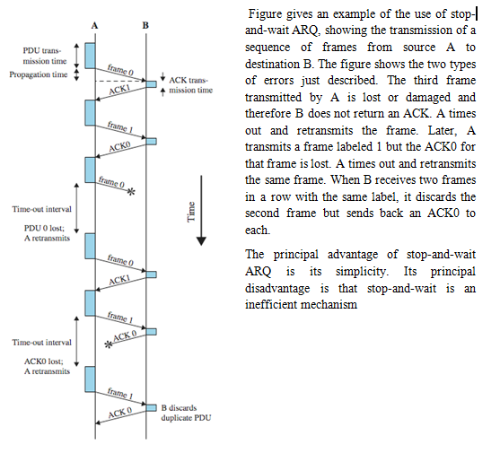

Slide 70
Go-Back-N-ARQ:
As in stop and wait protocol senders has to wait for every ACK the next frame is transmitted. But in go back N ARQ number of frames can be transmitted without waiting for ACK.
A copy of each transmitted frame is maintained until the respective ACK is received. The sliding-window flow control technique can be adapted to provide more efficient line use, sometimes referred to as continuous ARQ.
The form of error control based on sliding-window flow control that is most commonly used is called go-back-N ARQ. In this method, a station may send a series of frames sequentially numbered modulo some maximum value.

Slide 71
The number of unacknowledged frames outstanding is determined by window size, using the sliding-window flow control technique. While no errors occur, the destination will acknowledge incoming frames as usual (RR = receive ready, or piggybacked acknowledgment). If the destination station detects an error in a frame, it may send a negative acknowledgment (REJ = reject) for that frame. The destination station will discard that frame and all future incoming frames until the frame in error is correctly received. Thus, the source station, when it receives a REJ, must retransmit the frame in error plus all succeeding frames that were transmitted in the interim.
Suppose that station A is sending frames to station B. After each transmission, A sets an acknowledgment timer for the frame just transmitted. Suppose that B has previously successfully received frame (i – 1) and A has just transmitted frame i. The go-back-N technique takes into account the following contingencies:
1. Damaged frame
2. Lost Frame
3. Damaged Ack
4. Damaged Reject

Slide 72
1. Damaged frame – Error from ‘i’ frame. So, receiver rejects frame from ‘i’ frame and transmitter retransmits frames from i
2. Lost Frame - frame ‘i’ lost and either
i) transmitter sends i+1 and receiver gets frame i+1 out of sequence and rejects frame ‘i’
ii) or transmitter times out and send ACK with P bit set which receiver responds to with ACK ‘i’ Transmitter then retransmits frames from i
3. Damaged Ack –
receiver gets frame ‘i’ , sends ack (i+1) which is lost
if transmitter times out, it sends ack with P bit set
can be repeated a number of times before a reset procedure is initiated
4. Damaged Reject-
reject for damaged frame is lost handled as for lost frame when transmitter times out.

Slide 73
Selective Reject ARQ:
Also called selective retransmission
With selective-reject ARQ, the only frames retransmitted are those that receive a negative acknowledgment, in this case called SREJ, or those that time out. Selective reject would appear to be more efficient than go-back-N, because it minimizes the amount of retransmission.
On the other hand, the receiver must maintain a buffer large enough to save post-SREJ frames until the frame in error is retransmitted and must contain logic for reinserting that frame in the proper sequence. The transmitter, too, requires more complex logic to be able to send a frame out of sequence. Because of such complications, select-reject ARQ is much less widely used than go-back-N ARQ. Selective reject is a useful choice for a satellite link because of the long propagation delay involved.
Advantages:
More efficient the go back N ARQ because it minimizes the amount of re-transmission.
Disadvantages:
Receiver must maintain large buffer size.

Slide 74
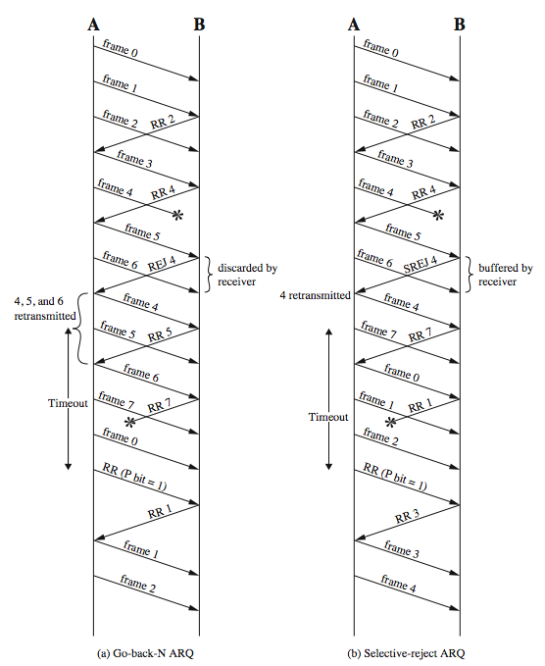
Figure a is an example of the frame flow for go-back-N ARQ. Because of the propagation delay on the line, by the time that an acknowledgment (positive or negative) arrives back at the sending station, it has already sent at least one additional frame beyond the one being acknowledged. In this example, frame 4 is damaged. Frames 5 and 6 are received out of order and are discarded by B. When frame 5 arrives, B immediately sends a REJ 4. When the REJ to frame 4 is received, not only frame 4 but frames 5 and 6 must be retransmitted. Note that the transmitter must keep a copy of all unacknowledged frames. Figure a also shows an example of retransmission after timeout. No acknowledgment is received for frame 5 within the timeout period, so A issues an RR to determine the status of B.
Figure b illustrates selective-reject ARQ. When frame 5 is received out of order, B sends a SREJ 4, indicating that frame 4 has not been received. However, B continues to accept incoming frames and buffers them until a valid frame 4 is received. At that point, B can place the frames in the proper order for delivery to higher-layer software.

Slide 75
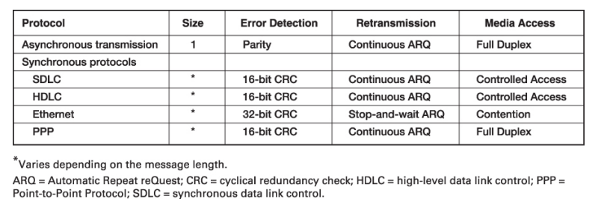
Data Link Protocols
In this section, we outline several commonly used data link layer protocols, which are summarized in Figure. Here we focus on message delineation, which indicates where a message starts and stops, and the various parts or fields within the message. For example, you must clearly indicate which part of a message or packet of data is the error-control portion; otherwise, the receiver cannot use it properly to determine if an error has occurred. The data link layer performs this function by adding a PDU to the packet it receives from the network layer. This PDU is called a frame.

Slide 76
Asynchronous Transmission:
Asynchronous transmission is so named because the timing of a signal is unimportant. Instead, information is received and translated by agreed upon patterns. As long as those patterns are followed, the receiving device can retrieve the information without regard to the rhythm in which it is sent. Patterns are based on grouping the bit stream into bytes. Each group, usually 8 bits, is sent along the link as a unit. The sending system handles each group independently, relaying it to the link whenever ready, without regard to a timer.
In asynchronous transmission, we send 1 start bit (0) at the beginning and 1 or more stop bits (1) at the end of each byte. There may be a gap between bytes. This gap can be represented either by an idle channel or by a stream of additional stop bits. By this method, each byte is increased in size to at least 10 bits, of which 8 bits is information and 2 bits or more are signals to the receiver.

Slide 77
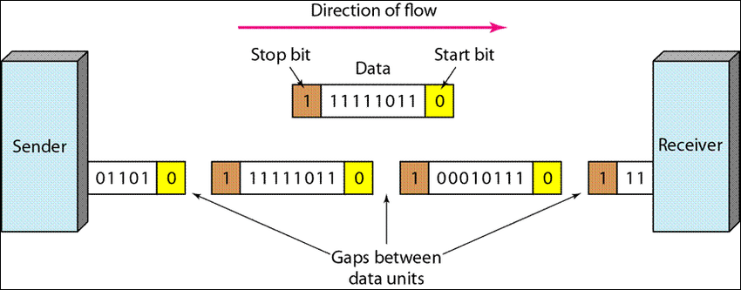
Asynchronous here means "asynchronous at the byte level," but the bits are still synchronized; their durations are the same. Figure above is schematic illustration of asynchronous transmission. In this example, the start bits are Os, the stop bits are 1s, and the gap is represented by an ideal line rather than by additional stop bits.

Slide 78
Synchronous Transmission:
In synchronous transmission, the bit stream is combined into longer "frames," which may contain multiple bytes. Each byte, however, is introduced onto the transmission link without a gap between it and the next one. It is left to the receiver to separate the bit stream into bytes for decoding purposes. In other words, data are transmitted as an unbroken string of 1s and 0s, and the receiver separates that string into the bytes, or characters, it needs to reconstruct the information.
Figure below gives a schematic illustration of synchronous transmission. In synchronous transmission, we send bits one after another without start or stop bits or gaps. It is the responsibility of the receiver to group the bits.

Slide 79
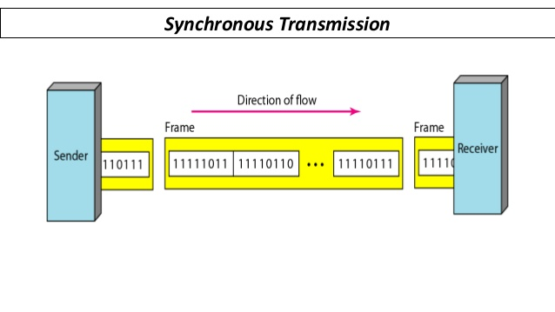
The advantage of synchronous transmission is speed. With no extra bits or gaps to introduce at the sending end and remove at the receiving end, and, by extension, with fewer bits to move across the link, synchronous transmission is faster than asynchronous transmission. For this reason, it is more useful for high speed applications such as transmission of data from one computer to another. Byte synchronization is accomplished in the data link layer. We need to emphasize one point here. Although there is no gap between characters in synchronous serial transmission, there may be uneven gaps between frames.

Slide 80
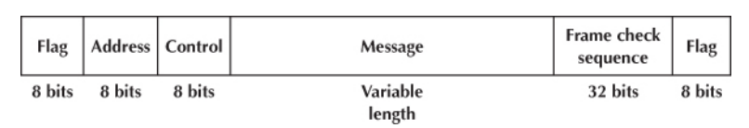
Synchronous Data Link Control (SDLC):
Synchronous data link control (SDLC) is a mainframe protocol developed by IBM in 1972 that is still in use today. It uses a controlled-access media access protocol.
Each SDLC frame begins and ends with a special bit pattern (01111110), known as the flag. The address field identifies the destination. The length of the address field is usually 8 bits but can be set at 16 bits; all computers on the same network must use the same length. The control field identifies the kind of frame that is being transmitted, either information or supervisory. An information frame is used for the transfer and reception of messages, frame numbering of contiguous frames, and the like. A supervisory frame is used to transmit acknowledgments (ACKs and NAKs). The message field is of variable length and is the user’s message. The frame check sequence field is a 32-bit CRC code (some older versions use a 16-bit CRC).

Slide 81
High Level Data Link Control (HDLC):
High-level Data Link Control (HDLC) is a bit-oriented protocol for communication over point-to-point and multipoint links. HDLC is a synchronous Data Link layer bit-oriented protocol developed by the International Organization for Standardization (ISO). The current standard for HDLC is ISO 13239.HDLC was developed from the Synchronous Data Link Control (SDLC) standard proposed in the1970s. HDLC provides both connection-oriented and connectionless service. HDLC is essentially the same as SDLC, except that the address and control fields can be longer.

Slide 82
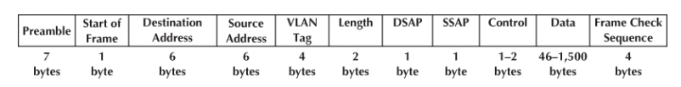
Ethernet:
Ethernet is a very popular LAN protocol, conceived by Bob Metcalfe in 1973 and developed jointly by Digital, Intel, and Xerox in the 1970s. Since then, Ethernet has been further refined and developed into a formal standard called IEEE 802.3ac. There are several versions of Ethernet in use today. Ethernet uses a contention media access protocol. There are several standard versions of Ethernet. Figure shows an Ethernet 803.3ac frame.

Slide 83
The frame starts with a 7-byte preamble, which is a repeating pattern of ones and zeros (10101010).
This is followed by a start of frame delimiter, which marks the start of the frame.
The destination address specifies the receiver, whereas the source address specifies the sender.
The length indicates the length in 8-bit bytes of the message portion of the frame.
The VLAN tag field is an optional 4-byte address field used by virtual LANs (VLANs. The Ethernet frame uses this field only when VLANs are in use; otherwise, the field is omitted, and the length field immediately follows the source address field.
The DSAP and SSAP are used to pass control information between the sender and receiver. These are often used to indicate the type of network layer protocol the packet contains.
The control field is used to hold the frame sequence numbers and ACKs and NAKs used for error control, as well as to enable the data link layers of communicating computers to exchange other control information.
The last 2 bits in the first byte are used to indicate the type of control information being passed and whether the control field is 1 or 2 bytes.
In most cases, the control field is 1-byte long. The maximum length of the message is about 1,500 bytes. The frame ends with a CRC-32 frame check sequence used for error detection.

Slide 84
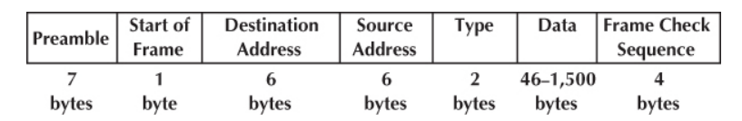
Ethernet II is another commonly used version of Ethernet. Like SDLC, it uses a preamble to mark the start of the frame. It has the same source and destination address format as Ethernet 802.3ac. The type field is used to specify an ACK frame or the type of network layer packet the frame contains (e.g., IP). The data and frame check sequence fields are the same as Ethernet 802.3ac.
Newer versions of these two types of Ethernet permits jumbo frames with up to 9,000 bytes of user data in the message field. Some vendors are experimenting with super jumbo frames that can hold up to 64,000 bytes. Neither jumbo nor super jumbo frame sizes have been standardized, but jumbo frames are common for some types of Ethernet such as gigabit Ethernet.
Ethernet-II Frame Layout

Slide 85
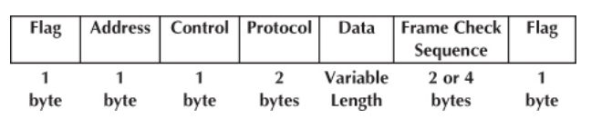
Point-to-point Protocol (PPP):
Although HDLC is a general protocol that can be used for both point-to-point and multi- point configurations, one of the most common protocols for point-to-point access is the Point-to-Point Protocol (PPP). Today, millions of Internet users who need to connect their home computers to the server of an Internet service provider use PPP. The majority of these users have a traditional modem; they are connected to the Internet through a telephone line, which provides the services of the physical layer. Figure below shows the basic layout of a PPP frame, which is very similar to an SDLC or HDLC frame.
PPP Frame Layout

Slide 86
The frame starts with a flag and has a 1-byte address (which is not used on point-to-point circuits). The control field is typically not used. The protocol field indicates what type of data packet the frame contains (e.g., an IP packet). The data field is variable in length and may be up to 1,500 bytes. The frame check sequence is usually a CRC-16 but can be a CRC-32. The frame ends with a flag.

Slide 87
Transmission Efficiency
One objective of a data communication network is to move the highest possible volume of accurate information through the network. The higher the volume, the greater the resulting network’s efficiency and the lower the cost. Network efficiency is affected by characteristics of the circuits such as error rates and maximum transmission speed, as well as by the speed of transmitting and receiving equipment, the error-detection and control methodology, and the protocol used by the data link layer.
Each protocol we discussed uses some bits or bytes to delineate the start and end of each message and to control error. These bits and bytes are necessary for the transmission to occur, but they are not part of the message. They add no value to the user, but they count against the total number of bits that can be transmitted.
Each communication protocol has both information bits and overhead bits. Information bits are those used to convey the user’s meaning. Overhead bits are used for purposes such as error checking and marking the start and end of characters and packets. A parity bit used for error checking is an overhead bit because it is not used to send the user’s data; if you did not care about errors, the overhead error checking bit could be omitted and the users could still understand the message.

Slide 88
Transmission efficiency is defined as the total number of information bits (i.e., bits in the message sent by the user) divided by the total bits in transmission (i.e., information bits plus overhead bits). For example, let’s calculate the transmission efficiency of asynchronous transmission. Assume that we are using 7-bit ASCII. We have 1 bit for parity, plus 1 start bit and 1 stop bit. Therefore, there are 7 bits of information in each letter, but the total bits per letter is 10 (7 + 3). The efficiency of the asynchronous transmission system is 7 bits of information divided by 10 total bits or 70%.
In other words, with asynchronous transmission, only 70% of the data rate is available for the user; 30% is used by the transmission protocol. If we have a communication circuit using a dial-up modem receiving 56 Kbps, the user sees an effective data rate (or throughput) of 39.2 Kbps. This is very inefficient.
We can improve efficiency by reducing the number of overhead bits in each message or by increasing the number of information bits. For example, if we remove the stop bits from asynchronous transmission, efficiency increases to 7/9 or 77.8%.

